Slide 1

DynamoDB
HackTricks Training
https://t.me/CyberFreeCourses

Slide 2
Basic Information
Amazon DynamoDB is a fully managed, serverless, key-value NoSQL database designed to run high-performance applications at any scale. DynamoDB offers built-in security, continuous backups, automated multi-Region replication, in-memory caching, and data export tools.
In DynamoDB you don't create a DB but you create a table. Each table needs to have configured a partition key is part of the table's primary key. It is a hash value that is used to retrieve items from your table and allocate data across hosts for scalability and availability. It's also possible to configure a sort key.
https://t.me/CyberFreeCourses
https://cloud.hacktricks.xyz/pentesting-cloud/aws-security/aws-services/aws-dynamodb-enum

Slide 3
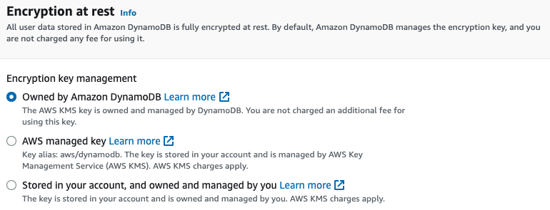
Encryption
By default, DynamoDB uses a KMS key that belongs to Amazon DynamoDB (not even the AWS managed key that at least belongs to your account).
For more info check https://docs.aws.amazon.com/kms/latest/developerguide/concepts.html#aws-owned-cmk
https://t.me/CyberFreeCourses
https://cloud.hacktricks.xyz/pentesting-cloud/aws-security/aws-services/aws-dynamodb-enum

Slide 4
Backups & Export to S3
It's possible to schedule the generation of table backups or create them on demand. Moreover, it's also possible to enable Point-in-time recovery (PITR) for a table. Point-in-time recovery provides continuous backups of your DynamoDB data for 35 days to help you protect against accidental write or delete operations.
It's also possible to export the data of a table to S3, but the table needs to have PITR enabled.
https://t.me/CyberFreeCourses
https://cloud.hacktricks.xyz/pentesting-cloud/aws-security/aws-services/aws-dynamodb-enum

Slide 5
Manual Enumeration
# Tables
aws dynamodb list-tables
aws dynamodb describe-table --table-name <t_name> #Get metadata info
## The primary key and sort key will appear inside the KeySchema field
# Check if point in time recovery is enabled
aws dynamodb describe-continuous-backups --table-name tablename
# Backups
aws dynamodb list-backups
aws dynamodb describe-backup --backup-arn <arn>
aws dynamodb describe-continuous-backups --table-name <t_name>
# Global tables
aws dynamodb list-global-tables
aws dynamodb describe-global-table --global-table-name <name>
# Exports
aws dynamodb list-exports
aws dynamodb describe-export --export-arn <arn>
# Misc
aws dynamodb describe-endpoints #Dynamodb endpoints
https://t.me/CyberFreeCourses
https://cloud.hacktricks.xyz/pentesting-cloud/aws-security/aws-services/aws-dynamodb-enum

Slide 6
Post Exploitation
DEMO
dynamodb:BatchGetItem | dynamodb:GetItem | dynamodb:Query | dynamodb:Scan | dynamodb:PartiQLSelect | dynamodb:ExportTableToPointInTime | dynamodb:CreateTable, dynamodb:RestoreTableFromBackup
Read sensitive information from DynamoDB tables or backups
dynamodb:PutItem | dynamodb:UpdateItem
Exploitation of further vulnerabilities/bypasses by being able to add/modify data in a DynamoDB tableExploitation of further vulnerabilities/bypasses by being able to add/modify data in a DynamoDB table
dynamodb:DeleteTable | dynamodb:DeleteBackup
Data loss and inability to recover from a backup during a disaster recovery scenario.Data loss and inability to recover from a backup during a disaster recovery scenario.
SQL Injection | NoSQL injection | Raw Json Injection | :property injection
https://t.me/CyberFreeCourses
https://cloud.hacktricks.xyz/pentesting-cloud/aws-security/aws-post-exploitation/aws-dynamodb-post-exploitation
Notes:
Show how some injection could occur (in the terminal, no need to create a web app)

